Slide 1
PGR 210 - Natural Language Processing Lec11
By Huamin Ren
Huamin.ren@kristiania.no

Slide 2
Outline
Adding deeper memory to recurrent neural nets
Gating information inside neural nets
Classifying and generating text
Modeling language patterns

Slide 3
Outline
Adding deeper memory to recurrent neural nets
Gating information inside neural nets
Classifying and generating text
Modeling language patterns

Slide 4
1. 1 An example
The young woman, having found a free ticket on the ground, went to the movies.
A recurrent neural net is going to have difficulty picking up on the relationship between the subject “woman” and main verb “went” in this new, longer sentence.
The connection to “went” is underemphasized, we need a solution!

Slide 5
1.2 long short-term memory (LSTM)
LSTMs introduce the concept of a state for each layer in the recurrent network
The state acts as its memory – can be thought similarly as adding attributes to a class in object oriented programming
The memory state’s attributes are updated with each training example

Slide 6
1.2 long short-term memory (LSTM)
LSTM can be trained to learn:
What to remember
While the rest of the recurrent net learns to predict the target label
Dependencies can be learned
stretch not just one or two tokens away, but across the entirety of each data sample

Slide 7
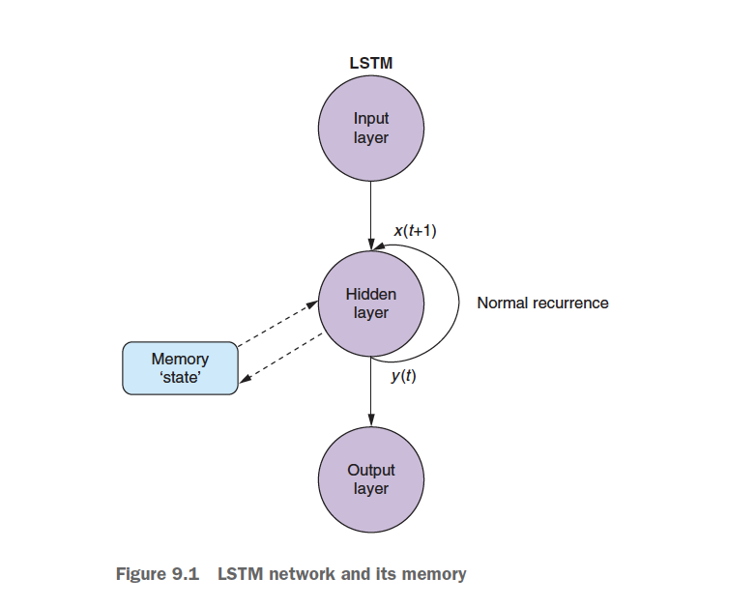
1.2 long short-term memory (LSTM)

Slide 8
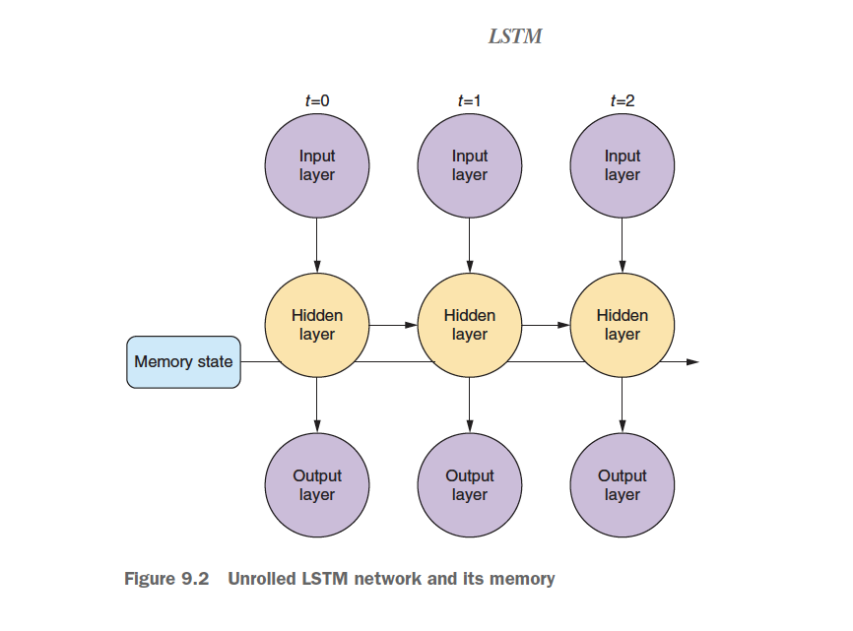
1.2 long short-term memory (LSTM)

Slide 9
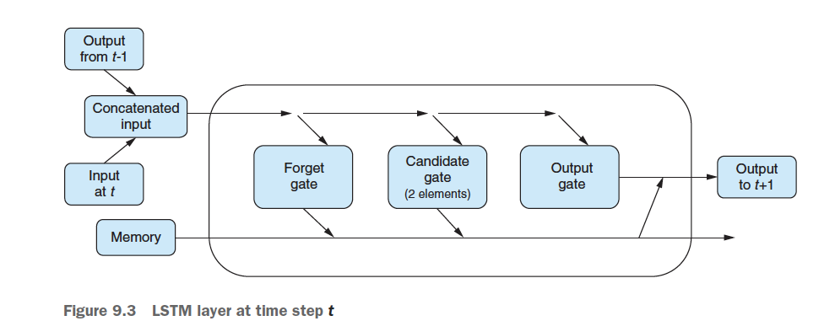
1.2 long short-term memory (LSTM)
As information flows into the
cell instead of a vector of weights, it’s now greeted by three gates:
a forget gate
An input/candidate gate
and an output gate

Slide 10
Outline
Adding deeper memory to recurrent neural nets
Gating information inside neural nets
Classifying and generating text
Modeling language patterns

Slide 11
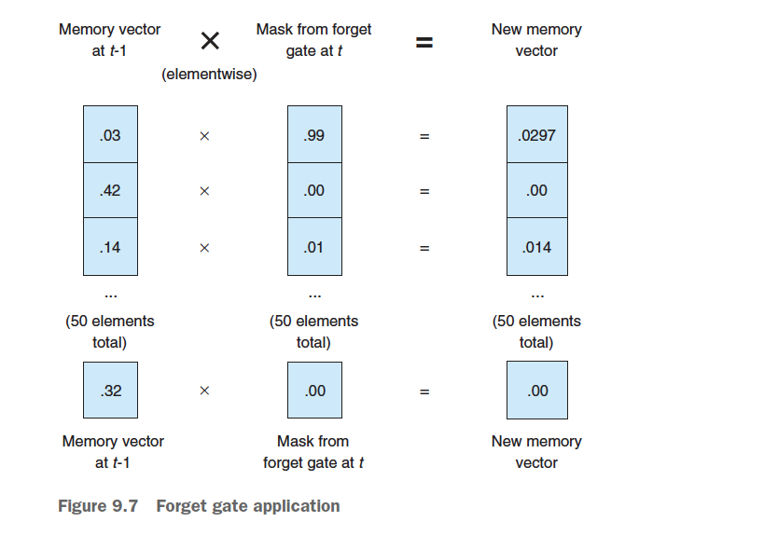
2.1 Forget gate
The output vector of the forget gate is then a mask (kind of) - erases elements of the memory vector
As the forget gate outputs values closer to 1, more of the memory’s knowledge in the associated element is retained for that time step
As the closer to 0, more of that memory value is erased

Slide 12
2.2 The candidate gate
Decide which input vector elements are worth remembering -similar to the mask in the forget gate
Route the remembered input elements to the right memory “slot”
The second part of this gate determines what values you’re going to update the memory with

Slide 13
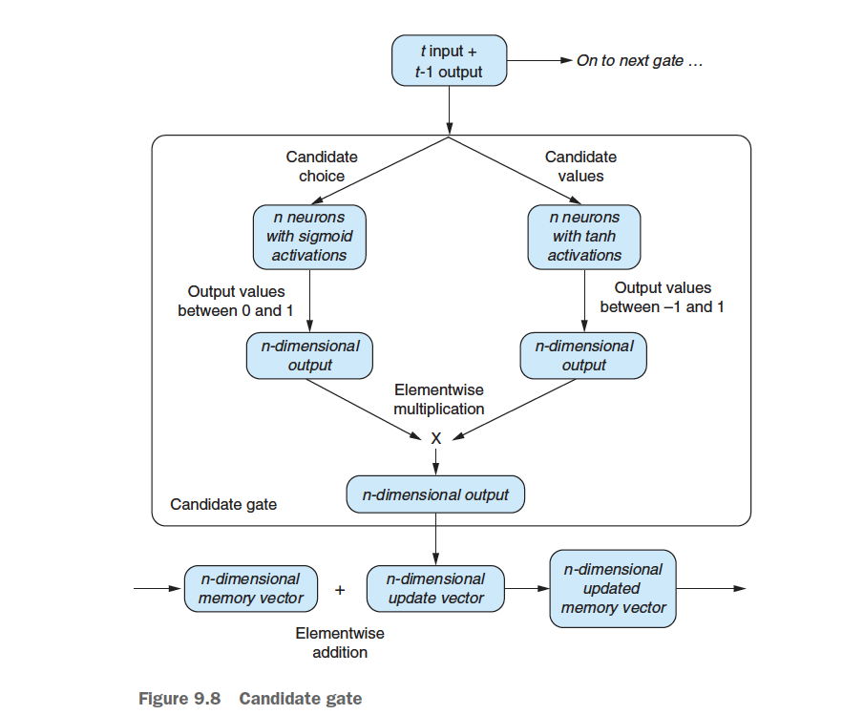

Slide 14
2.3 Output gate
Up until this point in the journey through the cell, only the memory to the cell is updated.
The output gate takes the input of the output of the cell at time step t-1 and passes it into the output gate.

Slide 15
Read textbook
30 min

Slide 16
Outline
Adding deeper memory to recurrent neural nets
Gating information inside neural nets
Classifying and generating text
Modeling language patterns

Slide 17
Putting together
Keras also comes with several tools, such as model.summary(), for inspection of the internals of your model.

Slide 18
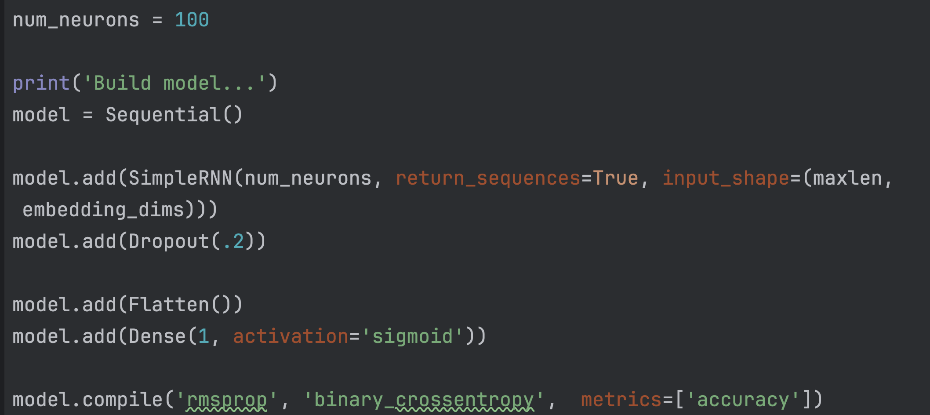

Slide 19
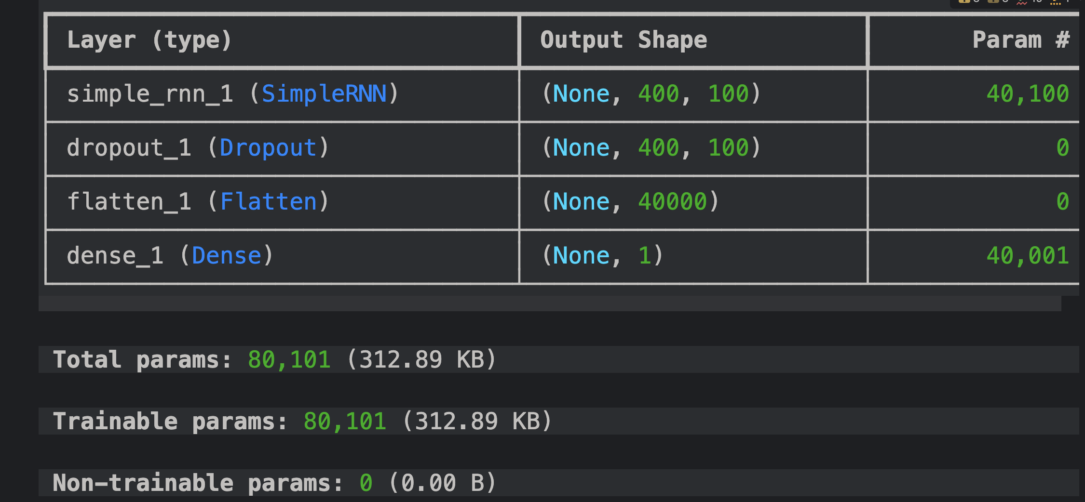

Slide 20
Parameters
Input dimension: 300 (?)
Neurons: 100
Weights for input x: 300*100
Weights for hidden (w_h): 100*100
Bias term before hidden: number of neurons, 100
30000 + 10000 + 100 = 40100 for the first layer
And so on….

Slide 21
Backpropagation through time (BPTT)
Backpropagation Through Time For Networks With Long-Term Dependencies
https://arxiv.org/pdf/2103.15589v3

